Slide 1
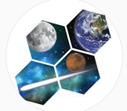



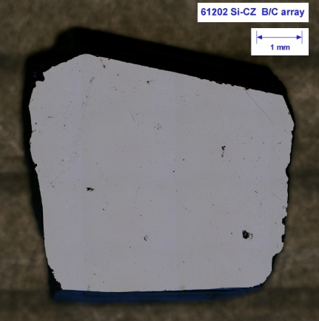
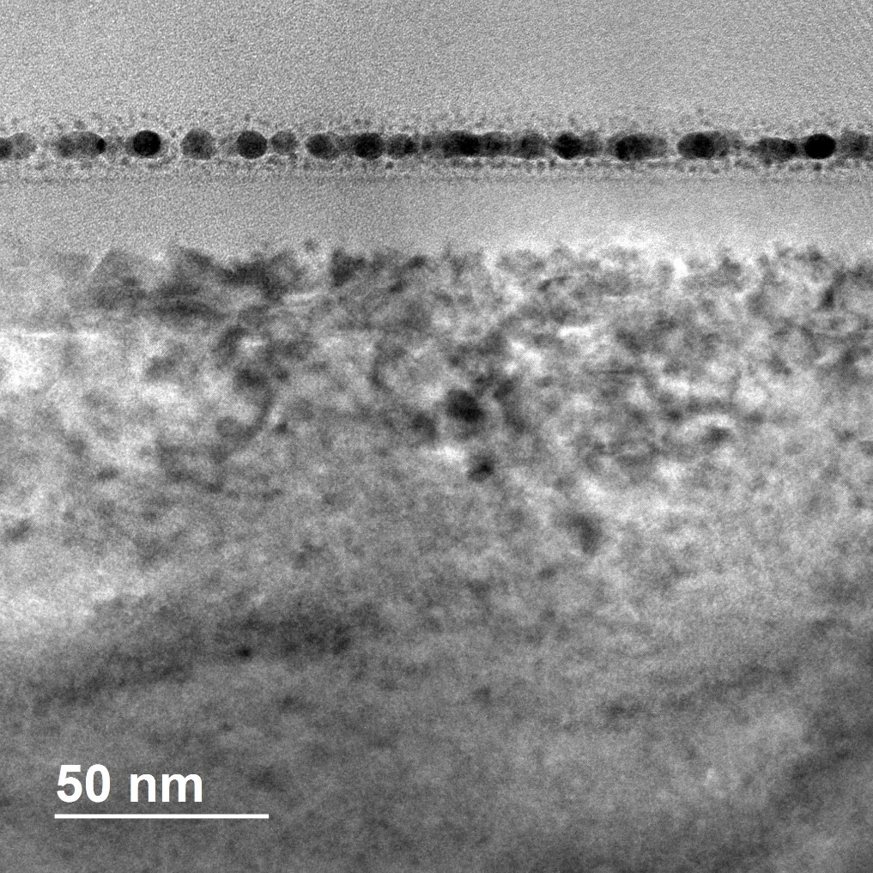
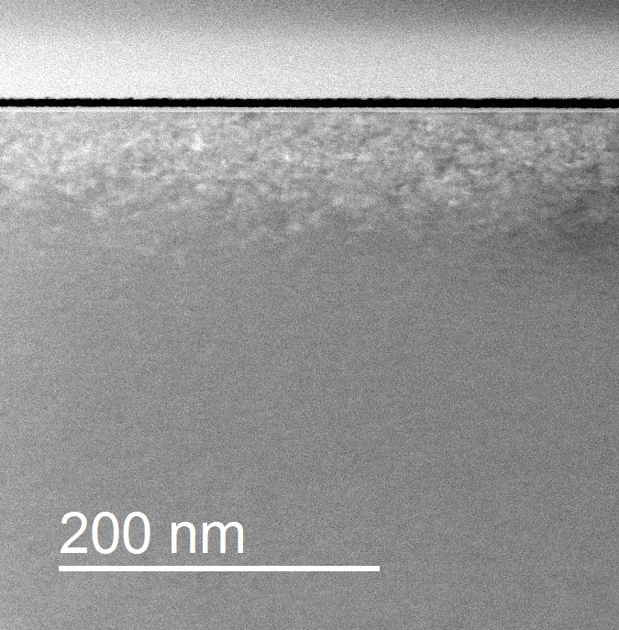
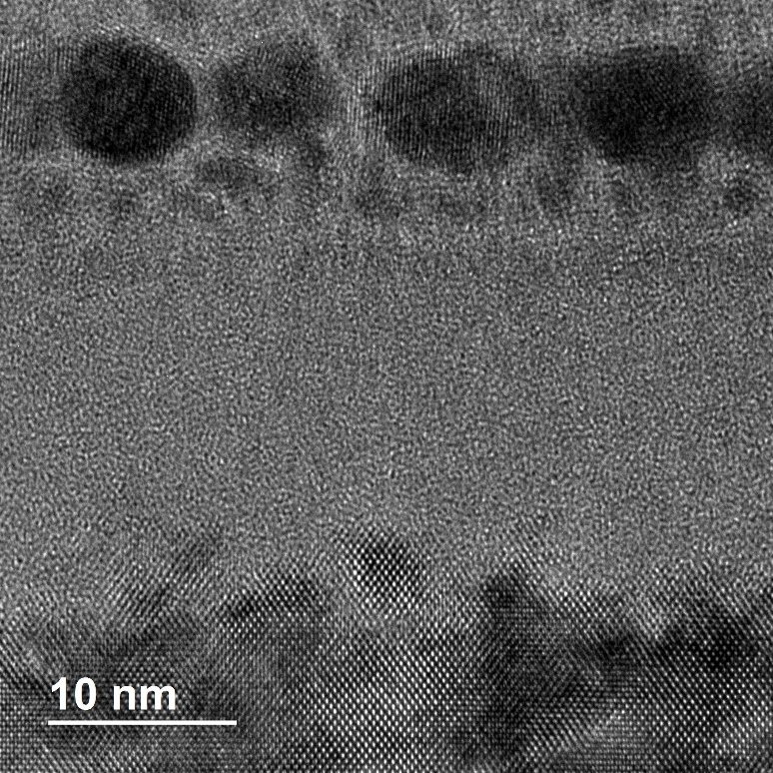
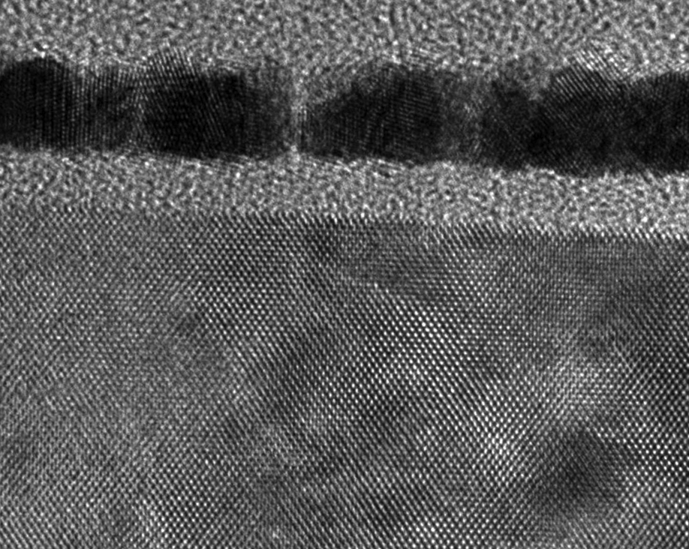
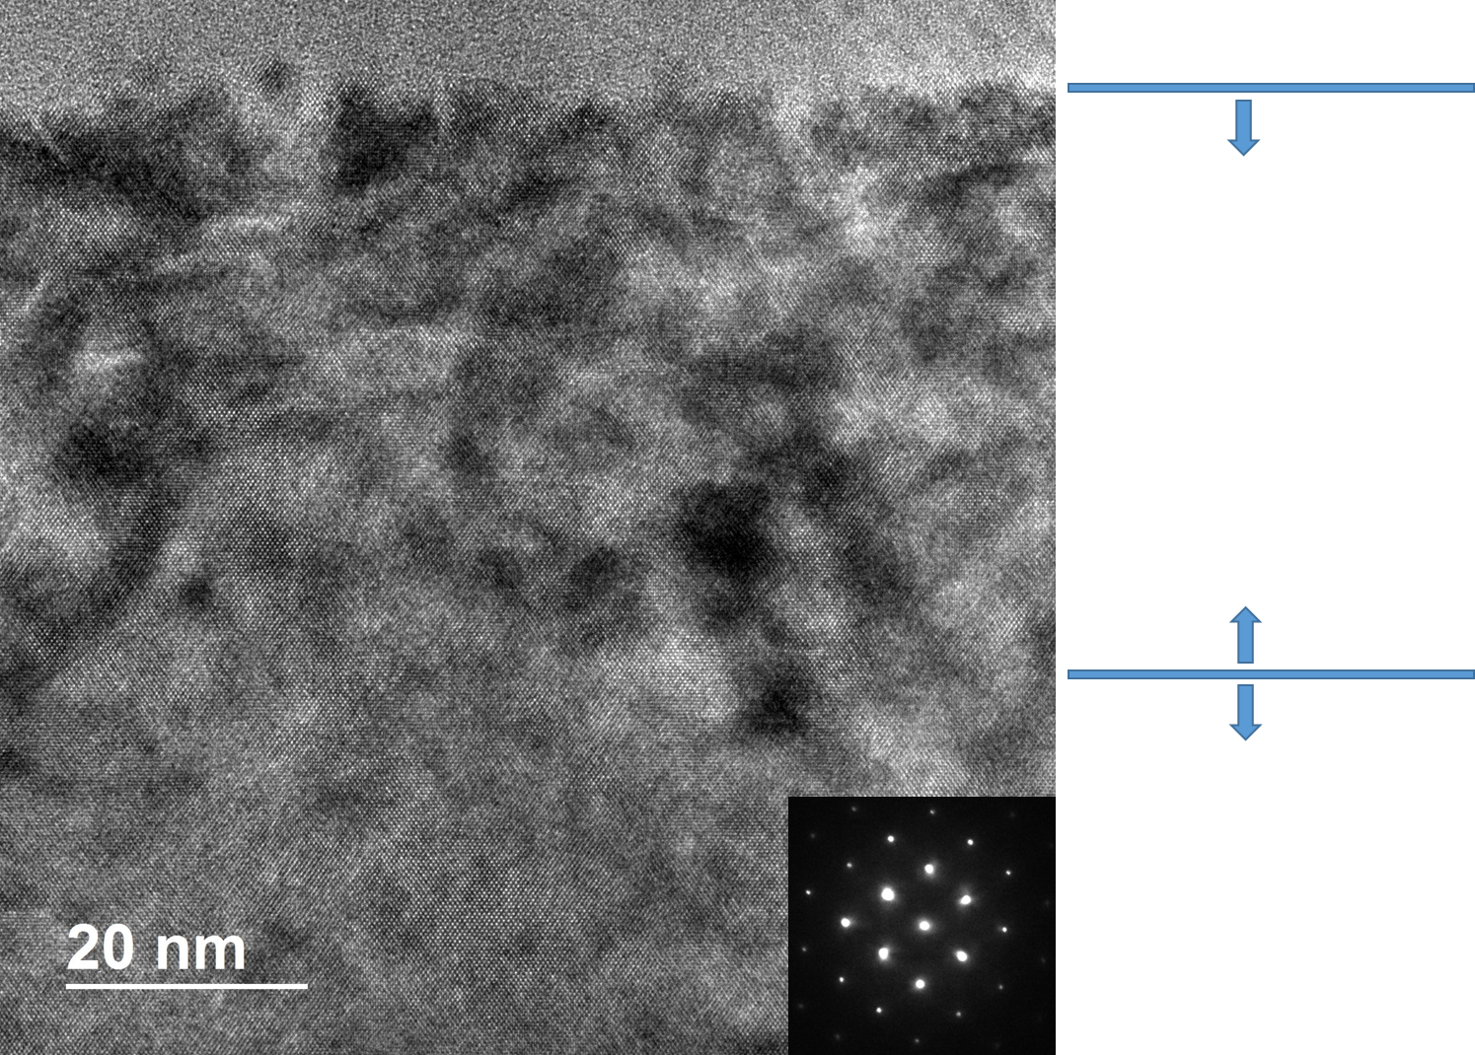
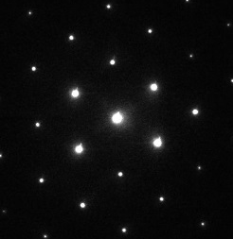
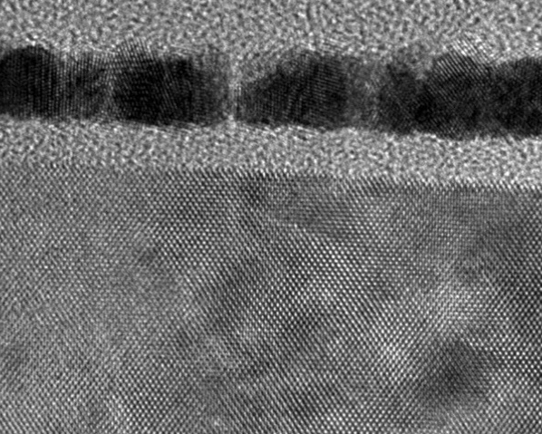
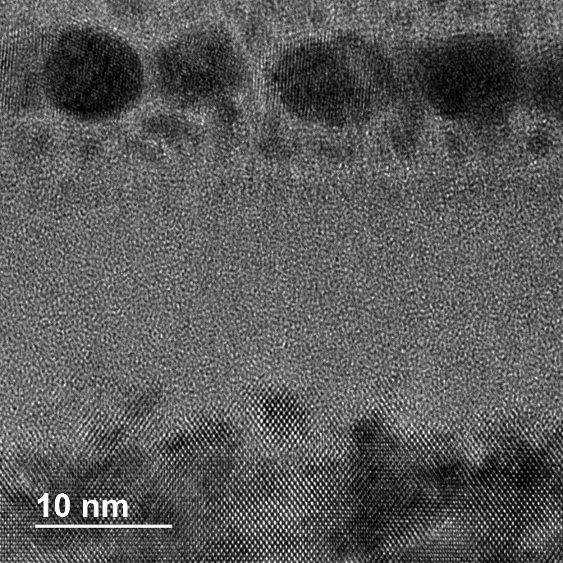
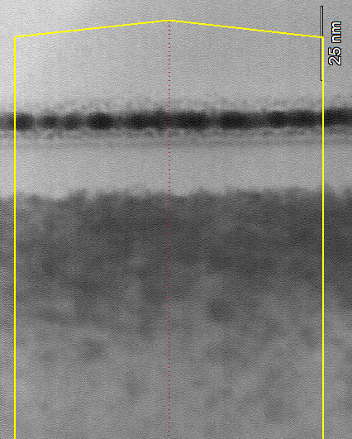
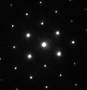
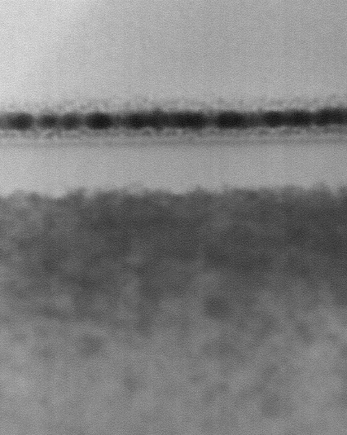




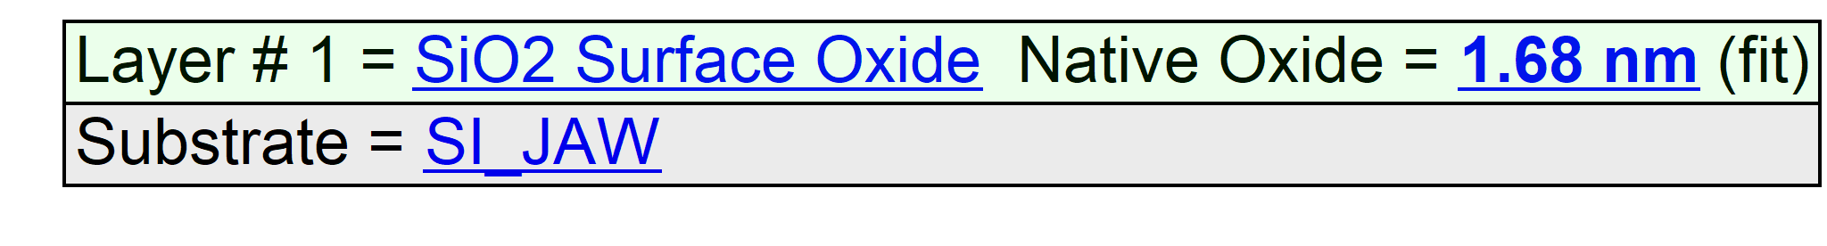
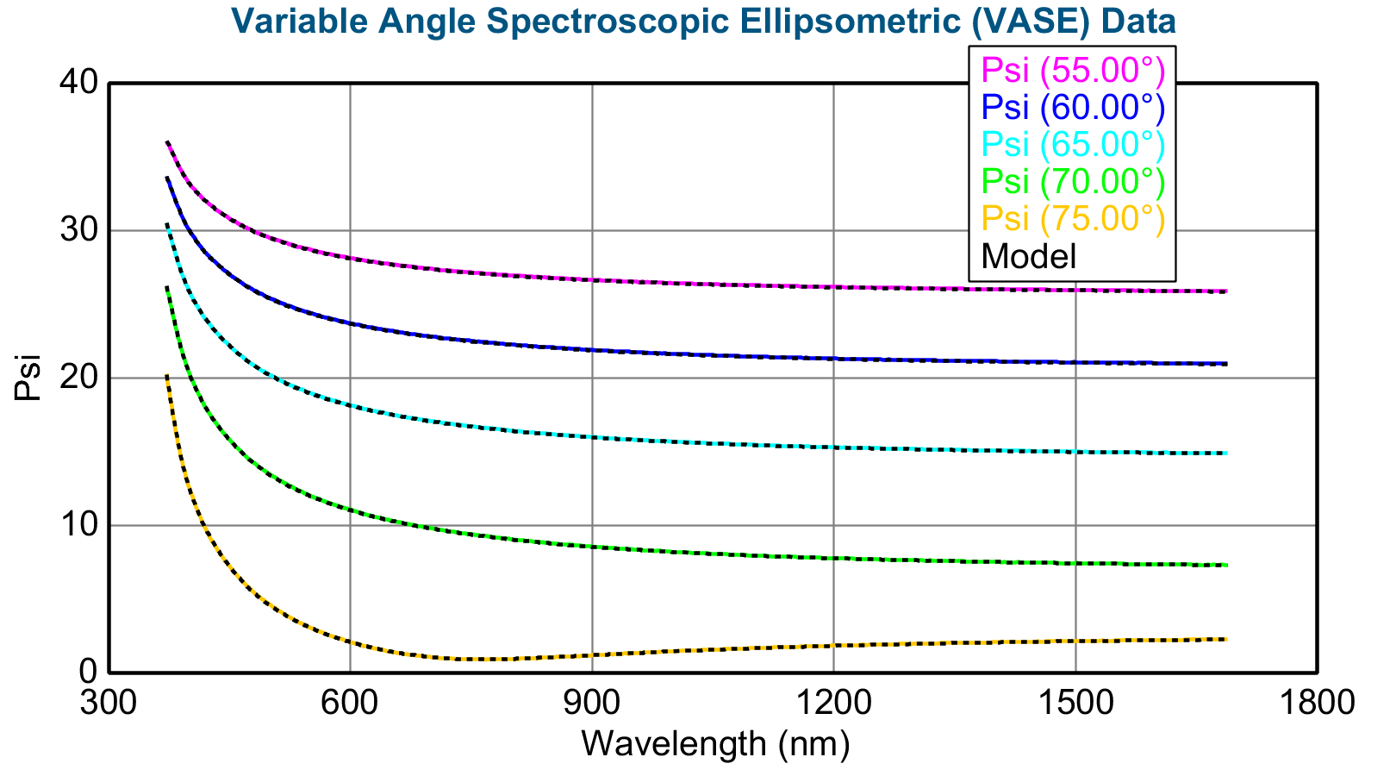
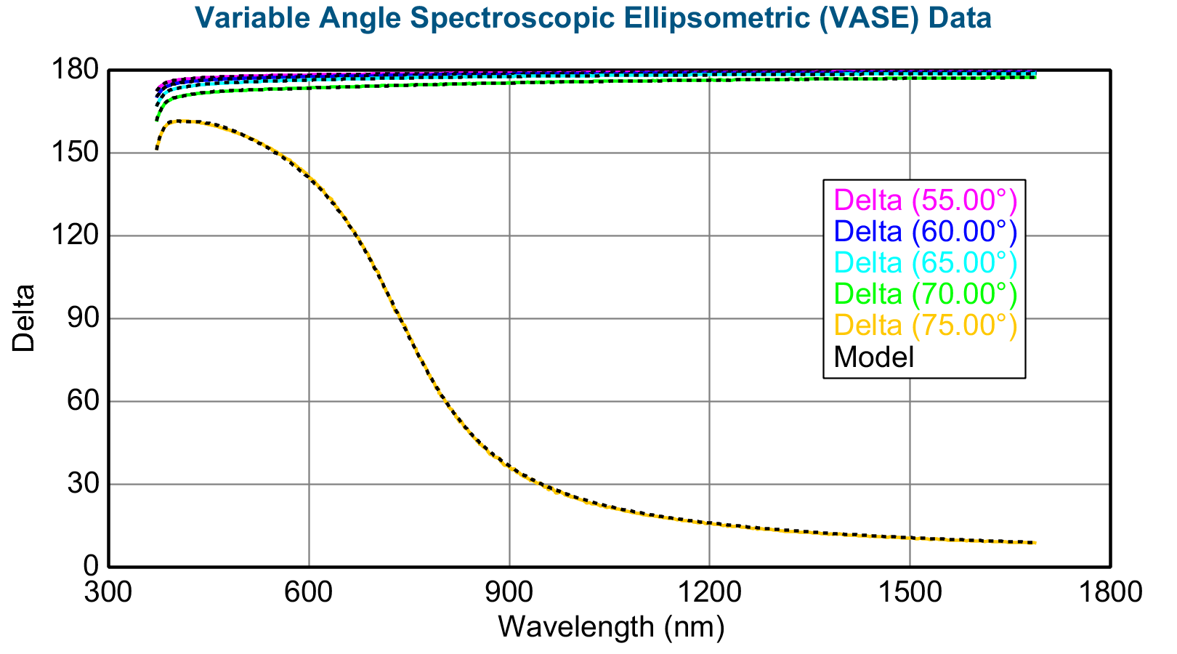
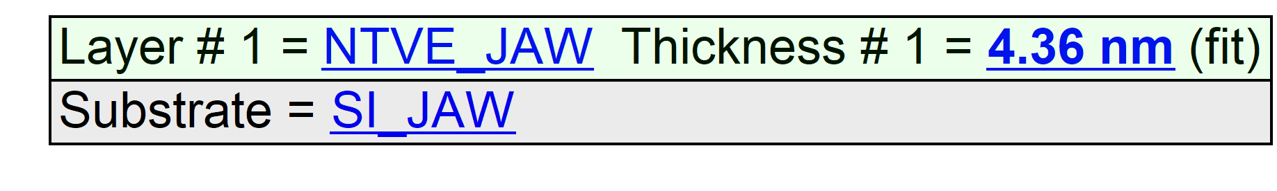
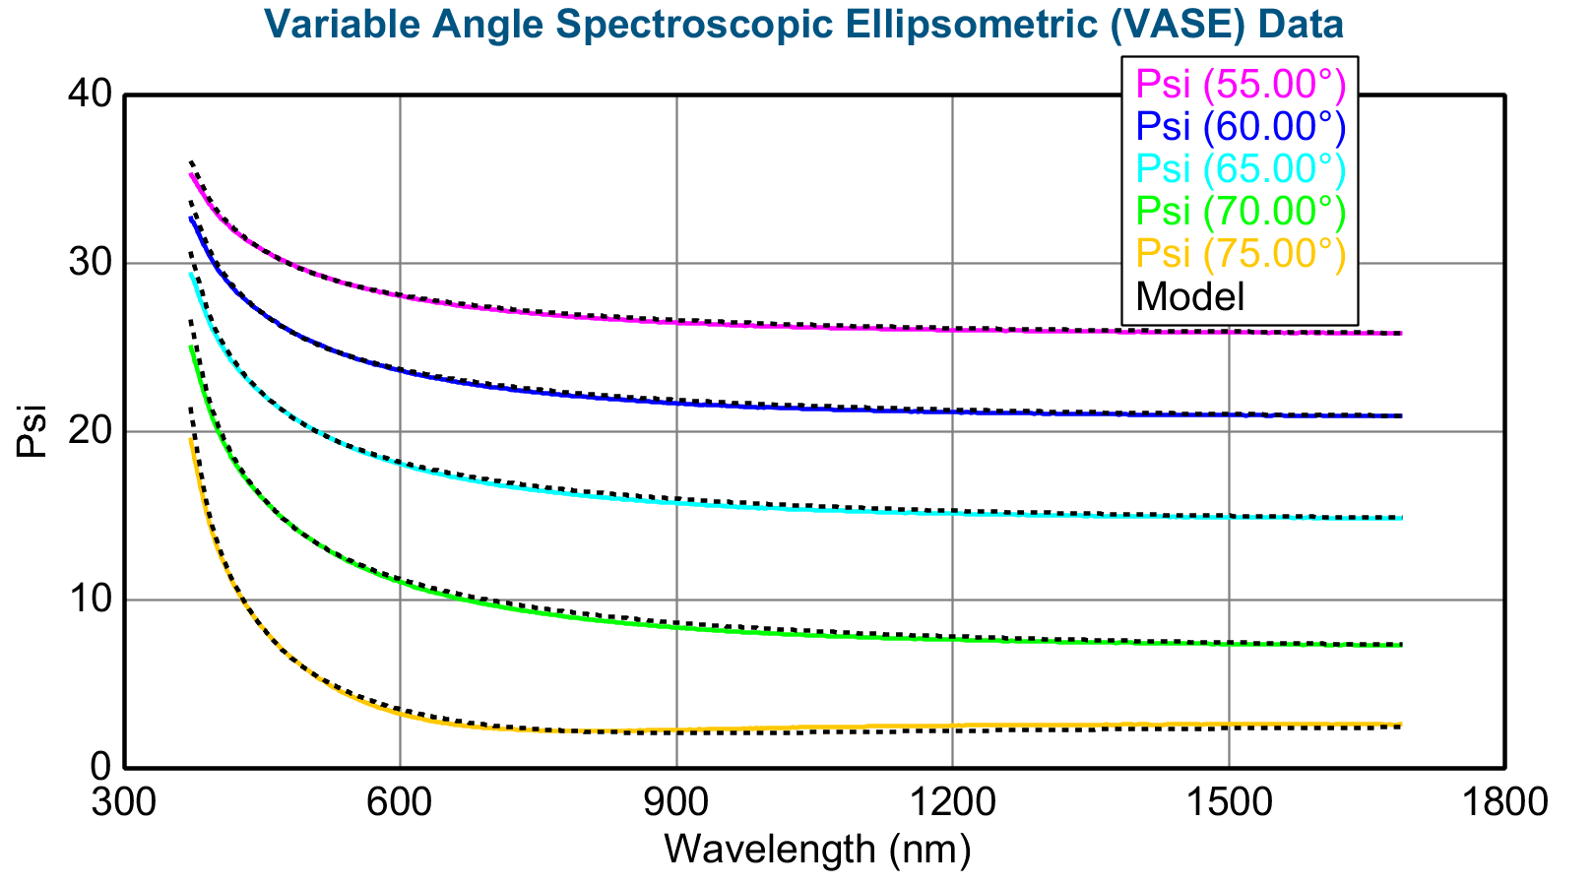
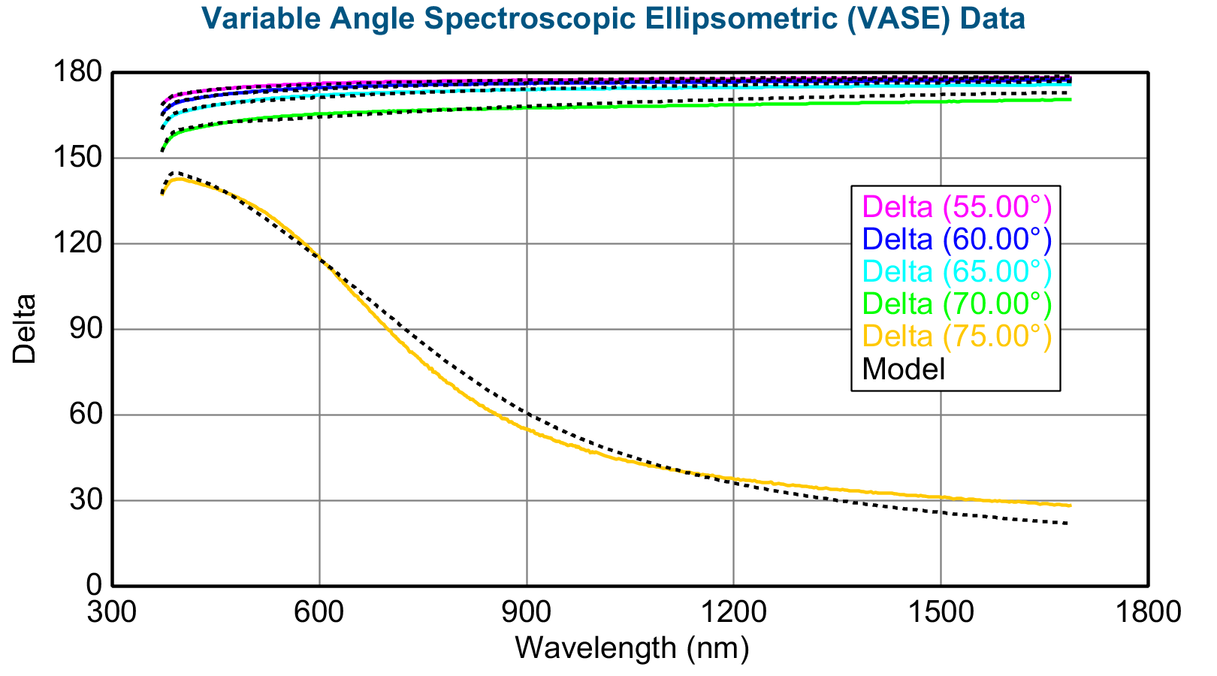
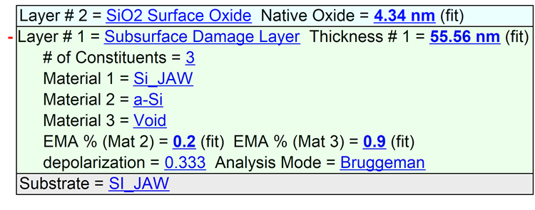
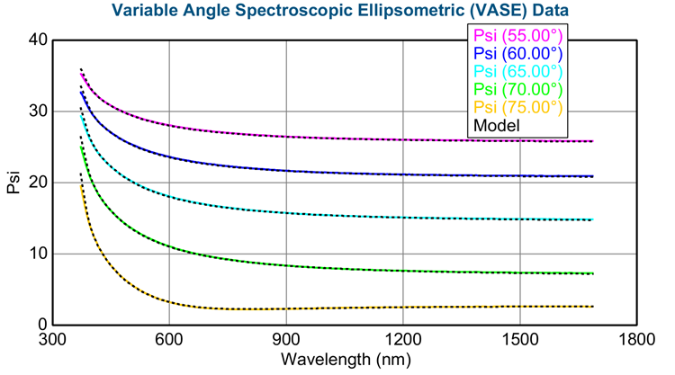

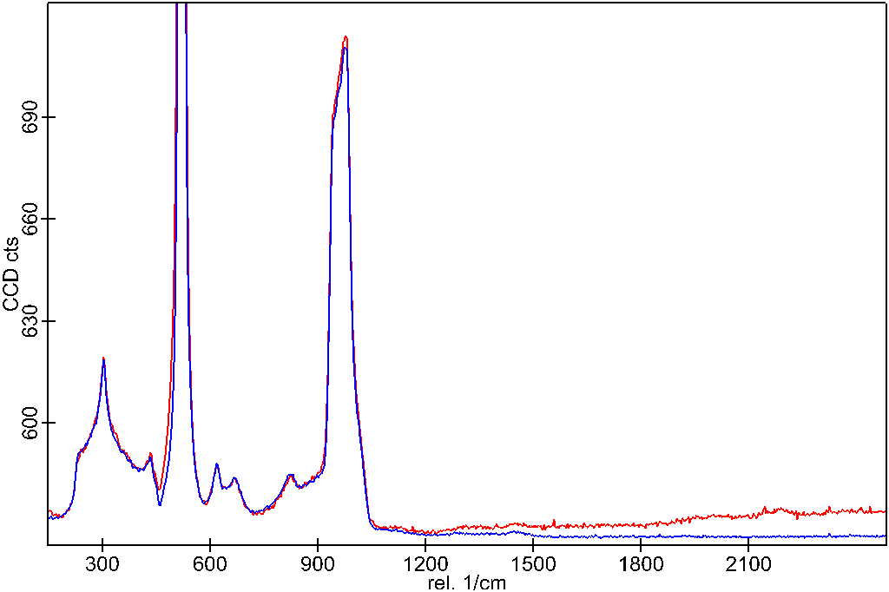
SOLAR WIND EFFECTS ON GENESIS SILICON COLLECTOR SUBSTRATE STRUCTURE:
OBSERVATION OF LAYERS IN TEM CROSS-SECTION
J. H. Allton.¹, L. P. Keller¹, Z. Rahman², C. P. Gonzalez², K. K. Allums², R. A. Synowicki³, A. J. G. Jurewicz⁴,and M. Fries¹, ¹NASA/Johnson Space Center, Mail Code XI, 2101 NASA Parkway, Houston, TX 77058, Judith.h.allton@nasa.gov, ²Jacobs Technology. 2224 Bay Area Blvd., Houston, TX 77058, ³J. A. Woollam Co. 645 M St., Lincoln, NE 68508, ⁴ASU/CMS P.O.#6004 Tempe, AZ 85287.
Observation of bulk solar wind damage in TEM Cross-sections
Introduction: The Genesis Discovery Mission returned to Earth solar wind that was collected in passive substrates over 853 days from 2001 to 2004, in the declining phase of solar cycle 23, at Earth-Sun Lagrangian point, L1. Over 300 collectors, comprised of 9 high-purity materials, were exposed to the solar wind under 4 conditions: bulk solar wind or the individual regimes: coronal hole solar wind (CH, high speed), interstream solar wind (IS, low speed) or coronal mass ejections (CMEs). Regime samples are important for the interpretation of bulk solar wind results because each type of solar wind represents a different set of solar processes. The mission is described in [1]. The collector materials are described in [2]. Reisenfeld et al. [3] documented the in situ solar wind during the collection period, concluding that the state of the solar wind was typical of conditions over the past 4 solar cycles.
Bulk solar wind silicon, CZ
61202
Bulk solar wind silicon, CZ
60208
Protective carbon strap
60208 Sample – 2019 Sample preparation
Pt metal “marker” layer
BF STEM
Amorphized Si – no lattice fringes
E-beam deposited carbon protective strap
Strained Si – dark/light contrast
Pt marker layer
Native oxide layer, amorphous
Quest to Develop a Useful Ellipsometry Model for Silicon Collectors: The pre-flight purpose of ellipsometry was for Curation to assess molecular film contamination on Genesis returned collectors. However, on flown samples, ellipsometry data was difficult to model, suggesting structural changes induced by solar wind [4, 5, 6, 7]. The current effort is to investigate silicon surface oxide formation from aging and from handling (e.g., cleaning, analysis, etc). The intent is to define the parameters needed for ellipsometry models. That is, obtaining thicknesses and characteristics of surface layers to be modeled, from TEM cross-sections of typical collectors. Keller and Rahman produced a TEM cross-section of sample 61202, a bulk solar wind in Czochralski silicon exhibiting a distinct amorphized layer. They produced a second TEM cross-section from sample 60208, also a bulk solar wind CZ silicon not exhibiting a distinct amorphized layer – a mystery to be solved!
“damaged” Si – still crystalline, but strained
undamaged Si – uniform contrast
High-resolution (HRTEM) image of the amorphous Si layer
Bulk “undamaged” Si
Pt metal “marker” layer
Amorphized Si – no lattice fringes
Carbon protective strap
Strained Si – dark/light contrast
Pt marker layer
Development Process for Simple Model
Samples of bulk solar wind and slow speed solar wind were investigated with ellipsometry to characterize the surface properties and lattice strain resulting from solar wind. Spectroscopic ellipsometry is an experimental technique for determining the thickness and optical properties of thin films from submonolayer up to several microns. Elliptically polarized light, from UV to infrared wavelengths, is used as a probe. The ellipsometric quantities measured are Δ, the phase shift of the component of light in the plane of incidence compared to the component perpendicular to the plane of incidence, and Ψ, the tangent of which equals the ratio of amplitudes of the electric fields in those two directions [14]. We started by modeling the surface oxide on an unflown CZ sample, a pristine reference sample. This was followed by applying this native oxide model to samples exposed to increasingly longer times to the solar wind. The bulk solar wind required that a subsurface damage layer be included in the modeling, and the best fit was a subsurface damage layer with about 1% a-Si and 1% void. See results in Table by Synowicki.
Examples
CZ Pristine reference sample, MSE=0.564
B/C sample 61202, Native oxide model, MSE=5.657
B/C sample 61202, EMA model with subsurface damage layer
c-Si + a-Si + void, MSE=3.151
High-resolution (HRTEM) image of the solar wind “damaged” Si layer
Native oxide layer (~2.5 nm)
Amorphized Si – no lattice fringes
Damaged crystalline silicon (~60 nm)
Strained Si – dark/light contrast
10 nm
[110]
Undamaged Si – uniform contrast
Energy dispersive X-ray maps from the FIB section – light blue line marks the bottom of the Pt marker layer
10 nm
[110]
Si
O
C
Pt
Compare 61202 and 60208 structure
60208
61202
Element line scans through the layers – different Y-axis scales
61202
60208
Exposure Type | Days of Solar Wind | Array | Sample Number | Measurement Location | Native oxide thickness, nm | Subsurface Damage Needed? | Surface Damage Layer Thickness, nm | a-Si content, % | Void Content, % | MSE | Comments
Control Sample | 0 | Not Flown | CZ 319 | 1 | 1.68 | No | 0 | 0 | 0 | 0.564 | Not Flown, Reference Sample
Coronal Mass Ejection | 193 | E | 60315 | 1 | 3.18 | No | 0 | 0 | 0 | 1.334 | Thicker Native Oxide
 |  |  |  | 2 | 3.17 | No | 0 | 0 | 0 | 1.681 | Thicker Native Oxide
Coronal Mass Ejection | 193 | E | 60316 | 1 | 2.89 | No | 0 | 0 | 0 | 1.430 | Thicker Native Oxide
 |  |  |  | 2 | 2.89 | No | 0 | 0 | 0 | 1.432 | Thicker Native Oxide
Slow Solar Wind | 334 | L | 20662 | 1 | 5.14 | No | 0 | 0 | 0 | 5.116 | Thickest Native Oxide
Slow Solar Wind | 334 | L | 50559 | 1 | 5.67 | No | 0 | 0 | 0 | 3.083 | Thickest Native Oxide
Slow Solar Wind | 334 | L | 60310 | 1 | 4.76 | No | 0 | 0 | 0 | 2.549 | Thickest Native Oxide
Slow Solar Wind | 334 | L | 60658 | 1 | 7.21 | No | 0 | 0 | 0 | 3.110 | Thickest Native Oxide
Slow Solar Wind | 334 | L | 60801 | 1 | 7.33 | No | 0 | 0 | 0 | 3.043 | Thickest Native Oxide
Slow Solar Wind | 334 | L | 61070 | 1 | 6.42 | No | 0 | 0 | 0 | 2.138 | Thickest Native Oxide
Slow Solar Wind | 334 | L | 61226 | 1 | 3.76 | No | 0 | 0 | 0 | 2.546 | Thickest Native Oxide
Slow Solar Wind | 334 | L | 61356 | 1 | 3.68 | No | 0 | 0 | 0 | 2.620 | Thickest Native Oxide
Slow Solar Wind | 334 | L | 61369 | 1 | 3.97 | No | 0 | 0 | 0 | 2.475 | Thickest Native Oxide
Bulk Solar Wind | 852 | B/C | 60208 | 1 | 2.87 | Yes | 55.71 | 1.0 | 1.4 | 3.028 | Most Damage, Good Uniformity
 |  |  |  | 2 | 2.89 | Yes | 56.22 | 1.0 | 1.2 | 2.925 | Most Damage, Good Uniformity
 |  |  |  | 3 | 2.83 | Yes | 55.82 | 1.0 | 1.4 | 3.069 | Most Damage, Good Uniformity
 |  |  |  | 4 | 2.93 | Yes | 55.75 | 1.1 | 1.4 | 2.994 | Most Damage, Good Uniformity
 |  |  |  | 5 | 2.87 | Yes | 55.81 | 1.0 | 1.4 | 3.067 | Most Damage, Good Uniformity
Bulk Solar Wind | 852 | B/C | 60262 | 1 | 4.33 | Yes | 60.92 | 0.9 | 0.7 | 3.632 | Most Damage
 |  | B/C |  | 2 | 4.35 | Yes | 61.07 | 0.9 | 0.7 | 3.519 | Most Damage
Bulk Solar Wind | 852 | B/C | 60263 | 1 | 3.89 | Yes | 56.83 | 0.8 | 1.0 | 3.335 | Most Damage
Knowledge of the damage observed in TEM of Genesis silicon can directly effect the properties of the silicon.
Example (left), etching of the sample surface for the purpose of cleaning was shown to be directly proportional to the H implant profile as calculated by SRIM. Retention of specific SW elements may also be affected by radiation damage.
Ellipsometry has the potential for selecting samples for PI to meet specific cleaning and analysis needs.
References:
[1] Burnett, D. S. et al. (2003) Space Sci. Rev., 105, 509-534. [2] Jurewicz A. J. G. et al. (2003) Space Sci. Rev., 105, 535-560. [3] Reisenfeld, D. B. (2013) Space Sci. Rev. [4] McNamara K. M. and Stansbery E. K. (2005) LPSC XXXVI, #2402. [5] Stansbery E. K. and McNamara K. M.(2005) LPSC XXXVI, #2145. [6] Calaway, M. J. et al (2006) LPSC XXXVII. #1420. [7] Calaway, M. J. et al (2007) LPSC XXXVIII. #1632. [8] Heber, V. S. et al. (2012) Astrophys. J., v. 759/121. [9] Titov, A. I. et al. (2003) Semiconductors 37(3), 340-346. [10] King, B. et al. (2008) Appl. Surf. Sci., 255, 1455-1457. [11] Jurewicz A. J. G. et al. this meeting. [12] Paramasivan G. J. et al. (2018) LPSC XLIX, #2886. [13] Humayun M. (2011) LPS XLVII, Abstract #1211. [14] Tompkins H and Hilfiker J (2019) Spectroscopic Ellipsomtery, Momemtum Press, 159 pp.
potential technique for assessing crystal strain
Raman spectra of B/C CZ sample 62060
WITec alpha 300 R, single spectrum
Plot of etching rate of silicon with H concentration from Paramasivan et al. (2018) LPSC.

