Slide 1
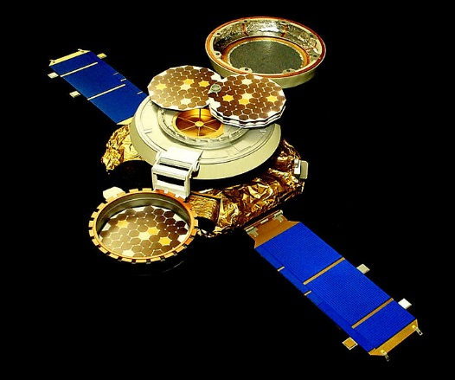
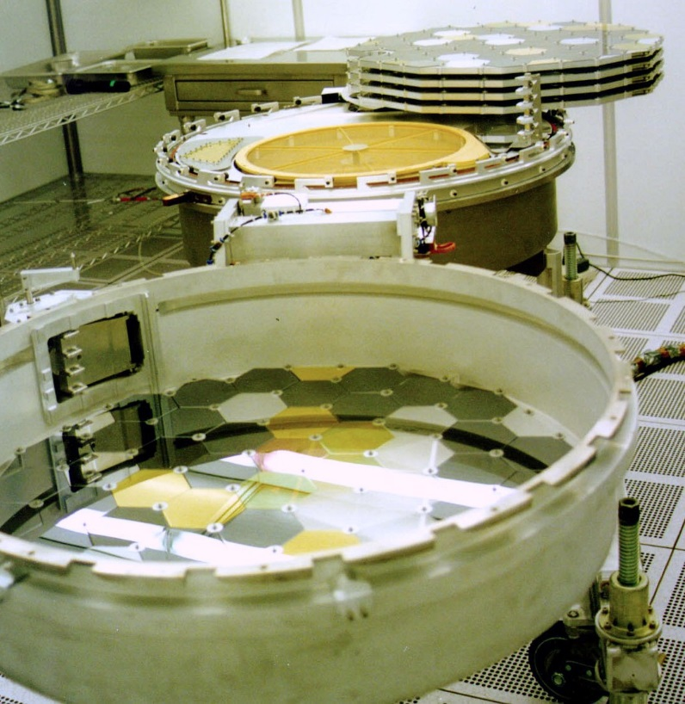
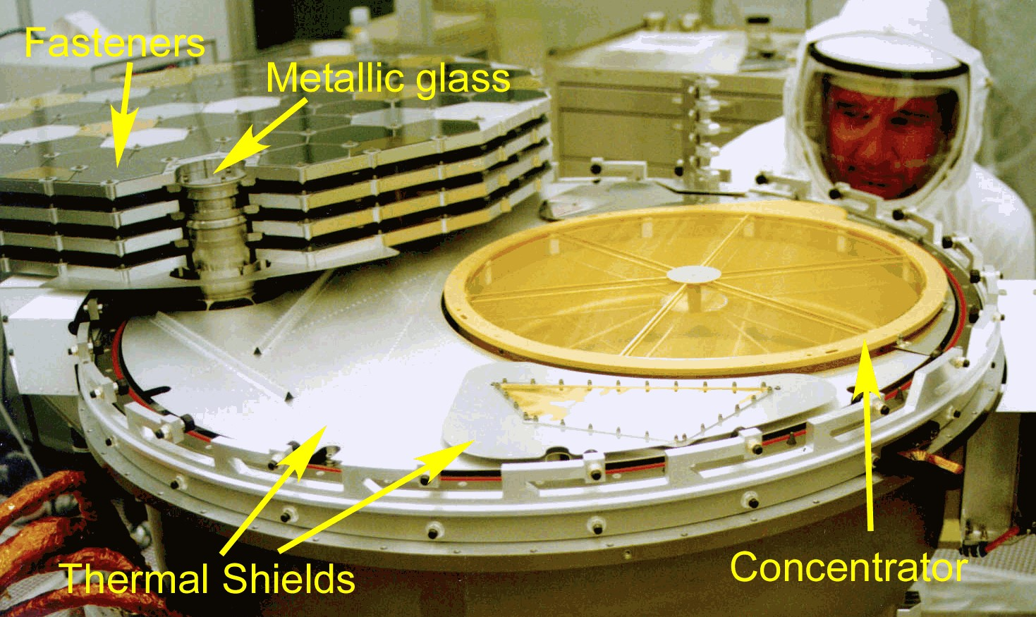
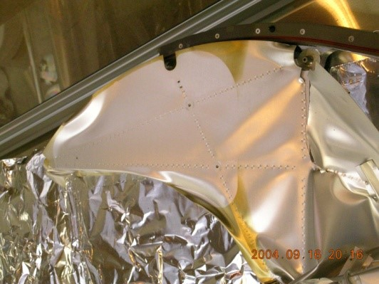
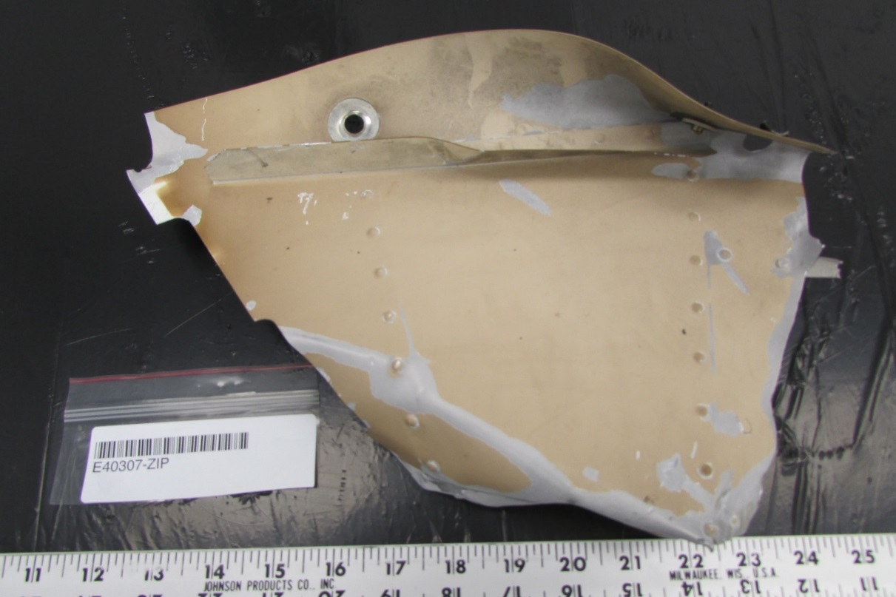
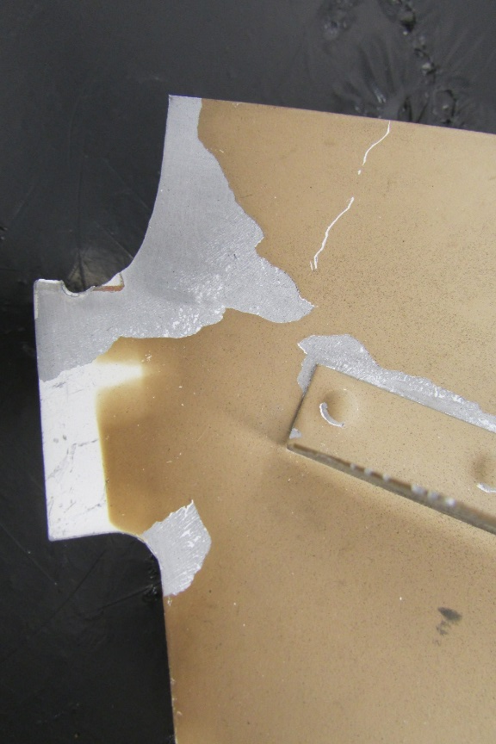


GENESIS SOLAR WIND SCIENCE CANISTER COMPONENTS CURATED AS POTENTIAL SOLAR WIND COLLECTORS AND REFERENCE CONTAMINATION SOURCES
J.H. Allton¹ K.K. Allums², C. P. Gonzalez³
¹NASA Johnson Space Center, Houston, TX 77058
²HX5,LLC-Jacobs JETS Contract, NASA Johnson Space Center, Houston, TX 77058, ³Jacobs, NASA Johnson Space Center, Houston, TX 77058
Introduction: The Genesis mission collected solar wind for 27 months at Earth-Sun L1 on both passive and active collectors carried inside of a Science Canister, which was cleaned and assembled in an ISO Class 4 cleanroom prior to launch. The primary passive collectors, 271 individual hexagons and 30 half-hexagons of semiconductor materials, are described in [1]. Since the hard landing reduced the 301 passive collectors to many thousand smaller fragments, characterization and posting in the online catalog remains a work in progress, with about 19% of the total area characterized to date [2, 3, 4]. Other passive collectors, surfaces of opportunity, have been added to the online catalog [4, 5, 6, 7]. This poster describes the next step, the cataloging of pieces of the Science Canister, which were surfaces exposed to the solar wind or component materials adjacent to solar wind collectors which may have contributed contamination. The online catalog of these solar wind collectors, a work in progress, can be found at:
http://curator.jsc.nasa.gov/gencatalog/index.cfm
Science Canister in Pre-Launch conditions: Pre-Launch Science Canister in closed & open configurations.
Science Canister Material Recovered After the
Hard Landing: About 100 pieces were preliminarily identified as being from the Science Canister at the Utah crash site. These are being examined and an updated inventory verified for the purpose of documenting these items more completely. The goal is to add solar wind exposed surfaces and potential contamination reference pieces to the online catalog of available specimens that can be subsampled for analysis. Preliminary inspection of larger Science Canister structural pieces is described in [17]. Surfaces exposed to the solar wind include the canister seal surface, aluminum thermal shields, hexagon fasteners, sun-facing surfaces of the concentrator structure and grids, canister side wall surfaces (Figs.4-8). Potential contamination reference materials from the canister include white thermal paint from the cover, Braycote lubricant, staking compound, molecular sieve components, electrical and cabling materials, and array deployment mechanism materials. [Much of the contamination previously reported on the primary passive collectors was debris from the Sample Return Capsule (a more materially complex and less clean spacecraft component) and the Utah lakebed sediments.] Cataloging of Science Canister materials has just been initiated and significant progress is expected in 2016.
Return Capsule Material Recovered After the
Hard Landing:
Genesis Capsule materials, have not yet been documented in detail. While preliminary examination of the Sample Return Capsule (SRC) thermal shield indicates many specimens are highly damaged and dirty, they are of interest because pre-flight documentation suggests these panels are painted with the same “white paint” as the canister cover. Figure 9 shows the science canister in place surrounded by the SRC thermal shield pre-flight. The thermal shield surfaces that were exposed to the sun were painted with a “white paint” ceramic coating composed of varying compositions of Zn, Al, Ga, and an inorganic binder. Below in figure 10 & 10a newly photographed sections of the thermal shield shows white paint that has browned significantly from sun exposure during the Genesis Mission. As there are parts of the thermal shield were shadowed and still the “original” white as opposed to the exposed brown sections, this could be an interesting study of the changes pre and post flight.
Fig. 2 Canister opened in solar wind collection configuration.
The Science Canister Prior to Launch: The Science Canister, a “tuna can” shape about 75 cm in diameter and 40 cm tall, was cleaned, assembled and closed under nitrogen purge in an ISO Class 4 cleanroom at Johnson Space Center (Fig. 1). It was not opened until on station at Earth-Sun L1 for solar wind collection. Rigorous precautions were taken to assure cleanliness of the canister interior and solar wind collectors [15]. Functionality of the canister is described in [16] (Figs. 2, 2a & 3). The primary passive collectors, the hexagons, were affixed to 5 arrays, each devoted to particular solar wind regimes: two arrays for bulk solar wind, 1 each for coronal mass ejection, high speed and interstream slow speed solar wind. Arrays for coronal mass ejection, high speed and low speed solar wind were shaded until appropriate solar wind regime was determined by on board instruments, then that specific array was deployed (unshaded). The three surfaces of opportunity (gold foil, polished aluminum alloy, metallic glass) and adjacent canister hardware were exposed to solar wind for the duration of collection. The primary passive collectors, the hexagons, were affixed to 5 arrays, each devoted to particular solar wind regimes: two arrays for bulk solar wind, 1 each for coronal mass ejection, high speed and interstream slow speed solar wind. Arrays for coronal mass ejection, high speed and low speed solar wind were shaded until appropriate solar wind regime was determined by on board instruments, then that specific array was deployed (unshaded). The three surfaces of opportunity (gold foil, polished aluminum alloy, metallic glass) and adjacent canister hardware were exposed to solar wind for the duration of collection. The Science Canister structure was aluminum 7075. The interior aluminum surface was bare aluminum – no anodizing or other surface finishing. The array frames were cut by electric discharge machining (EDM) from aluminum 6061 plate.
Fig. 2a Opened Science Canister
Fig. 3 – Sunward facing surfaces
Genesis Hard Landing – Hardware Before and After Conditions:
Fig. 4.Canister thermal shield prior to installation. Diameter is 75 cm.
Fig. 5. Canister thermal shield as returned after hard landing. Brown areas are where solar radiation darkened a molecular film.
Fig. 9 – The Capsule and Science Canister
Fig. 6. Close-up of canister thermal shield illustrating shading from direct solar radiation (see fig. 3).
Fig. 10a – Close up of the Thermal Shield section that shows the contrast between the white paint that was shadowed during sun exposure on the Genesis Mission
Fig. 10 – Thermal Shield section of the Return Capsule
References: [1] Jurewicz, A. J.G. et al. (2003) Space Sci. Rev. 105:535-560. [2] Stansbery, E. K, (2005) LPSC 36th, Abst. #2179. [3] Burkett, P. J. et al. (2009) LPSC 40th, Abst. # 1373. [4] Gonzalez, C. P. et al. (2015) LPSC 46th, Abst. #1950. [5] Allton, J. H. et al. (2005) LPSC 36th, Abst. #1806. [6] Rodriguez, M. C. et al. (2008) LPSC 39th, Abst. #2063. [7] Rodriguez, M. C. et al. 2011) LPSC 42nd Abst. #1968. [8] Nordholt, J. E. (2003) Space Sci. Rev. 105:561-599. [9] Calaway, M. J. et al. (2007) LPSC 38th Abst. #1632. [10] Calaway, M. J. et al. (2008) LPSC 39th Abst. #1423. [11] Allton, J. H. et al. (2008) LPSC 39th Abst. #1440. [12] Allton, J. H. et al. (2013) LPSC 44th Abst. #2466. [13] Burkett, P. J. et al. (2013) LPSC 44th Abst. #2837. [14] Lauer, H. V. et al. (2013) LPSC 44th Abst. #2691. [15] Stansbery, E. K. (2001) LPSC 32nd Abst. #2084. [16] Burnett, D. S. et al. (2003) Space Sci. Rev. 105:509-534. [17] Hittle, J. D. et al. (2006) LPSC 37th Abst. #1411. [18] Wiens, R. C. et al. (2013) Space Sci. Rev. 175:93-124.
Fig. 1 – Closed Science Canister pre-launch.
Fig. 7-8 – Concentrator before and after the Hard Landing

